Slide 1
Bank Marketing Analytics
Data set link:
https://www.kaggle.com/datasets/henriqueyamahata/bank-marketing
Porf: Amira Abdelatey
Eng: Abdullah Bassiouni

Slide 2
Table of contents
01
About Dataset
02
Data cleaning
03
04
Data Visualization
Machine Learning

Slide 3
01
About the project

Slide 4
About Dataset
The data is related with direct marketing campaigns of a Portuguese banking institution. The marketing campaigns were based on phone calls. Often, more than one contact to the same client was required, in order to access if the product (bank term deposit) would be ('yes') or not ('no') subscribed.

Slide 5
02
Data cleaning

Slide 6
Data cleaning
Data cleaning is the process of fixing or removing incorrect, duplicate, noisy, or incomplete data within a dataset. Through data cleaning phase, data wrangling has been conducted for modifying the data into a more usable form.

Slide 7
03
Data Visuallization

Slide 8
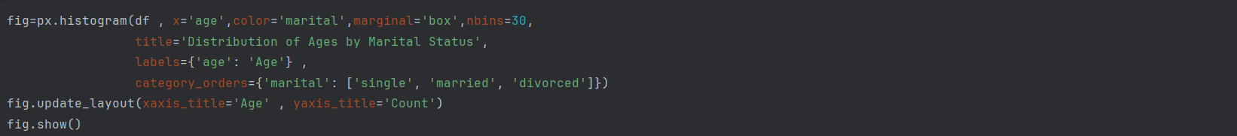
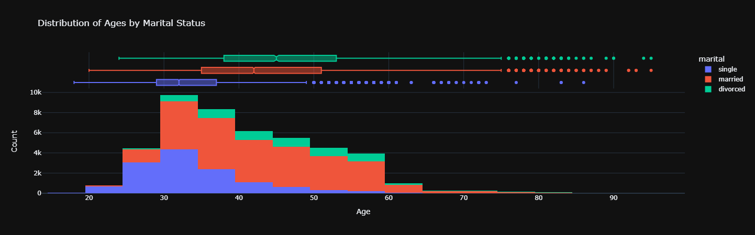
In which age most likely the client will deposit or not.

Slide 9
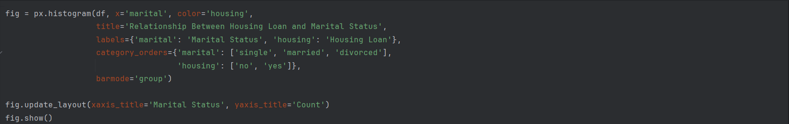
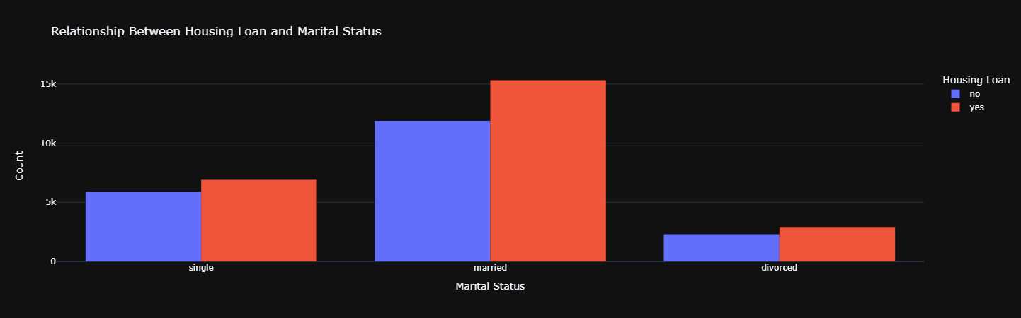
In which category the most likely marital status getting house loan.

Slide 10
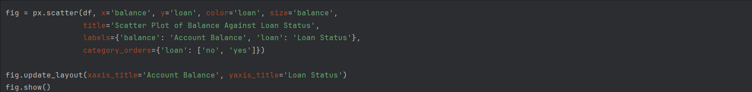
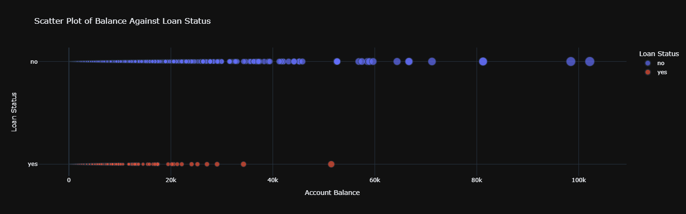
Having a high balance means not
having loans.

Slide 11
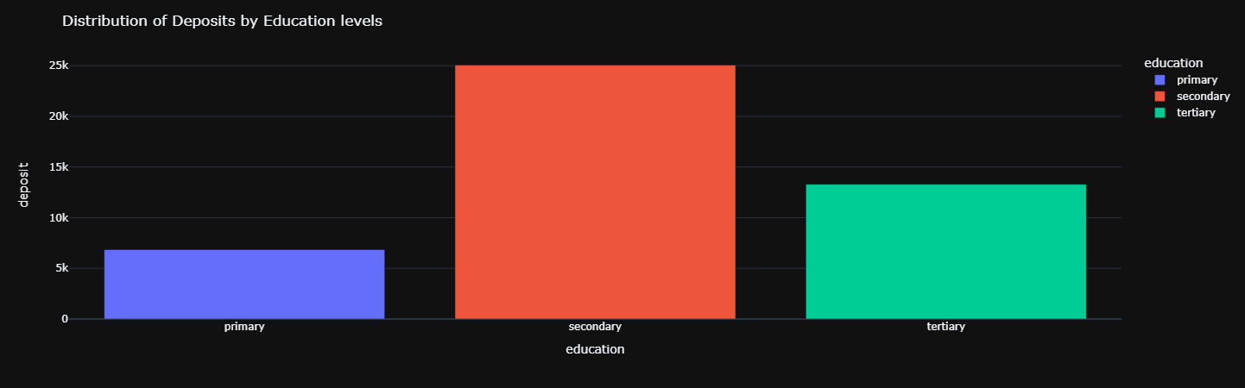
Distribution of deposit with different education levels.

Slide 12
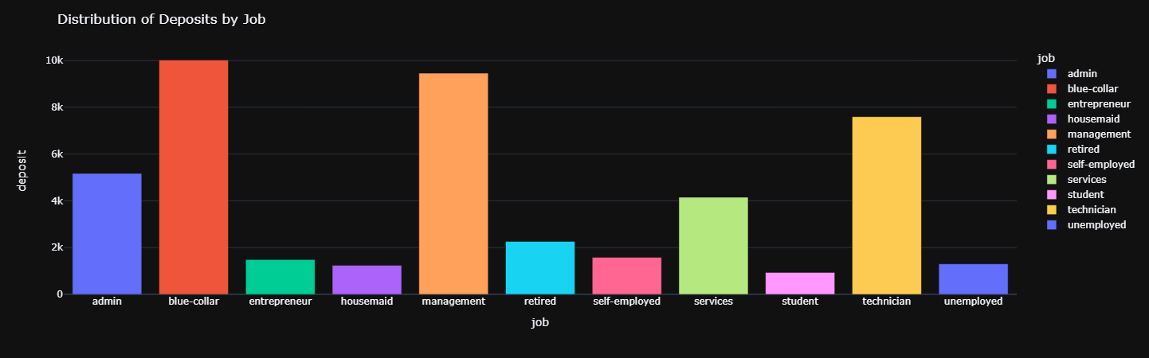
Distribution of deposit status among customers with different job types.

Slide 13
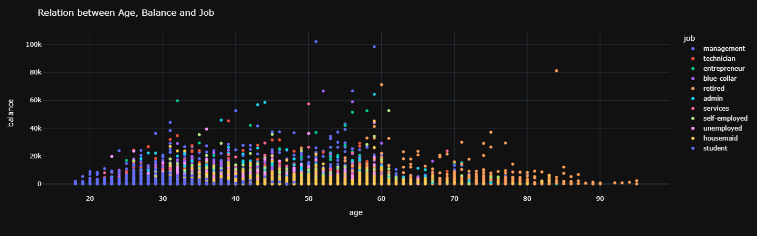
Displaying most important customers and their jobs.

Slide 14
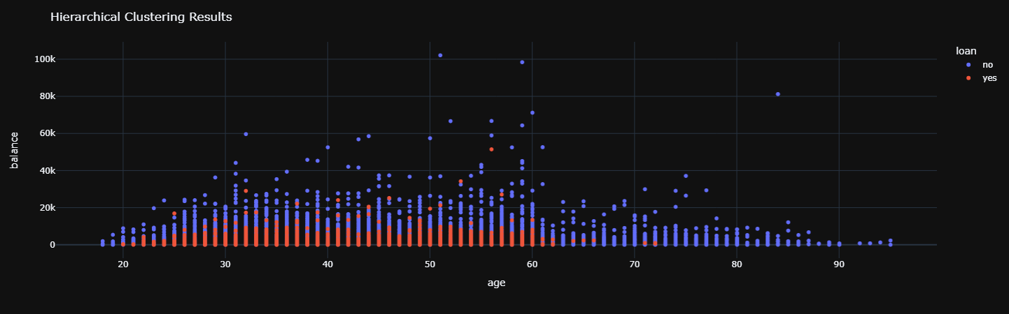
Possibility of getting a loan according to balance.

Slide 15
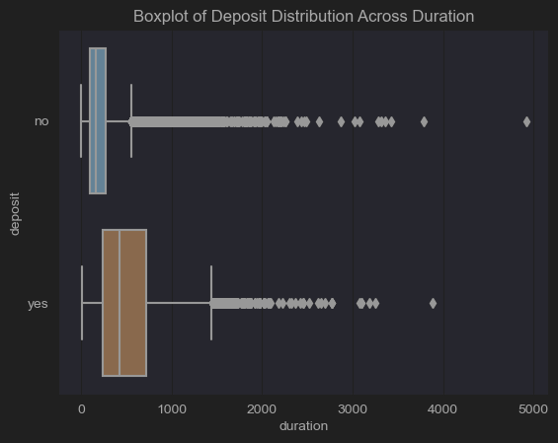
Relation between call duration and deposit.

Slide 16
04
Machine Learning

Slide 17
Random Forest Algorithm
Random Forest Technique
1- Is build on Decision Tree algorithm.
2- Consist of multiple trees(make forest) that are less sensitive to the training data.
3- Rain forest algorithm is more accurate than Decision tree.
4- Every tree in forest consist of pure leaf node and decision node.
5- We use random sampling with replacement to build number of datasets from original dataset (BootStrapping).
6- Each tree will train on different bootstrapped dataset independently.
7- We use Feature Selection to choose most suited feature to train each tree on it.
8- Prediction of the rainforest is the one that receives the most votes.

Slide 18
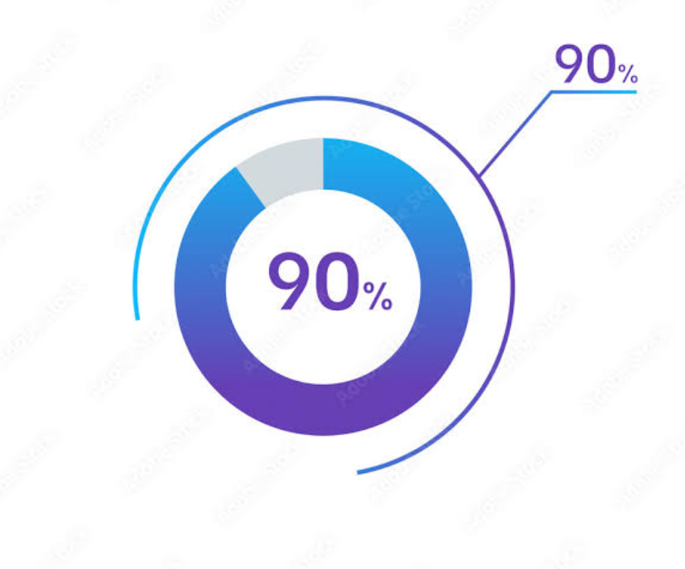

ML model accuracy
Which represent a strong correlationship

Slide 19
Thanks!
Designed by:
Ahmed Ibrahim Ibrahim Al-Sayed Ghannam
Khaled Saeed Hamed Abdel Fattah
Hesham Hatem Mohamed Helmy Al-Hefny
Mohammed Majid Mohammed Ibrahim Mukhaymer
Please keep this slide for attribution

